Slide 1
Data Mining
Ch 8/9: Classification – 1
Basic Concepts
Decision Tree Induction
Wan D. Bae, Ph.D.
baewd@hanyang.ac.kr

Slide 2
Overview
Classification: basic concepts
Classification methods:
  Decision tree induction
  Bayesian classification methods
  Neural networks
  Rule-based classification
Classification accuracy

Slide 3
Supervised vs. Unsupervised Learning
Supervised learning (classification)
  Supervision: The training data (observations, measurements, etc.) are accompanied by labels indicating the class of the observations
  New data is classified based on the training set
Unsupervised learning (clustering)
  The class labels of training data is unknown
  Given a set of measurements, observations, etc. with the aim of establishing the existence of classes or clusters in the data

Slide 4
Classification
Classification:
  predicts categorical class labels
  classifies data (constructs a model) based on the training set and the values (class labels) in a classifying attribute and uses it in classifying new data
Typical Applications
  credit approval: analyze which applications are “safe” and which are “risky”, {credit history, salary}-> credit approval ( Yes/No)
  target marketing: guess whether a customer with a given profile will buy a new product (“yes”) or not (“no)
  medical diagnosis: predict which of three specific treatments a patient should receive, “treatment A”, “treatment B”, “treatment C”

Slide 5
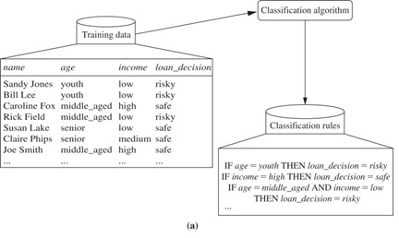
Example: Class Label Attribute
Learning: training data are analyzed by a classification algorithm
The learned model or classifier
The class label attribute:
loan_decision (“risky”, “safe”)

Slide 6
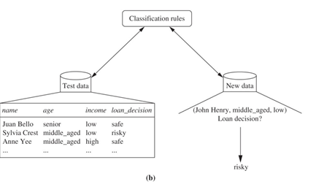
Example: Class Label Attribute
Classification: Test data are used to estimate the accuracy of the classification rules.
If the accuracy is considered acceptable, the rules can be applied to the classification of new data tuples.

Slide 7
Classification—A Two-Step Process
Step 1: Model construction
Step 2: Model usage
Model construction: describing a set of predetermined classes (learning step/training phase=학습단계,훈련과정):
  Each tuple/sample is assumed to belong to a predefined class, as determined by the class label attribute (categorical)
  The set of tuples used for model construction is training set
  This step is also called supervised learning: the class label of each training tuple is provided
  The model is represented as classification rules, decision trees, or mathematical formulae

Slide 8
Classification—A Two-Step Process Cont.
Step 1: Model construction
Step 2: Model usage
Model usage: for classifying future or unknown objects
  Estimate accuracy of the model(분류(모델)의 정확성 판단)
    The known label of test sample is compared with the classified result from the model
    Accuracy rate is the percentage of test set samples that are correctly classified by the model
    Test set is independent of training set, otherwise over-fitting will occur
  If the accuracy is acceptable, use the model to classify data tuples whose class labels are not known

Slide 9



Process 1: Model Construction
Classification
Algorithms
Training
Data
Classifier
(Model)
IF rank = ‘professor’
or years > 6
THEN tenured = ‘yes’

Slide 10




Process 2: Use the Model in Prediction
Classifier
Testing
Data
Unseen Data
(Jeff, Professor, 4)
Tenured?

Slide 11
Evaluating Classification Methods
Accuracy
  ability to correctly predict the class label
Speed
  computational cost to construct and use the model
Robustness
  making good prediction under noise and missing values
Scalability
  efficiency in disk-resident databases
Interpretability:
  Level of understanding and insight provided by the model → subjective

Slide 12
Classification by Decision Tree Induction
Decision tree induction: the learning of decision trees from class-labeled training tuples
Decision tree: a flowchart-like tree structure:
  each internal node is a test on an attribute
  each branch represents an outcome of the test
  each leaf node holds a class label
How are decision trees used for classification?
  given a tuple with unknown class label, the attribute values of the tuple are tested against the decision tree
  a path is traced from the root to the class label leaf node

Slide 13
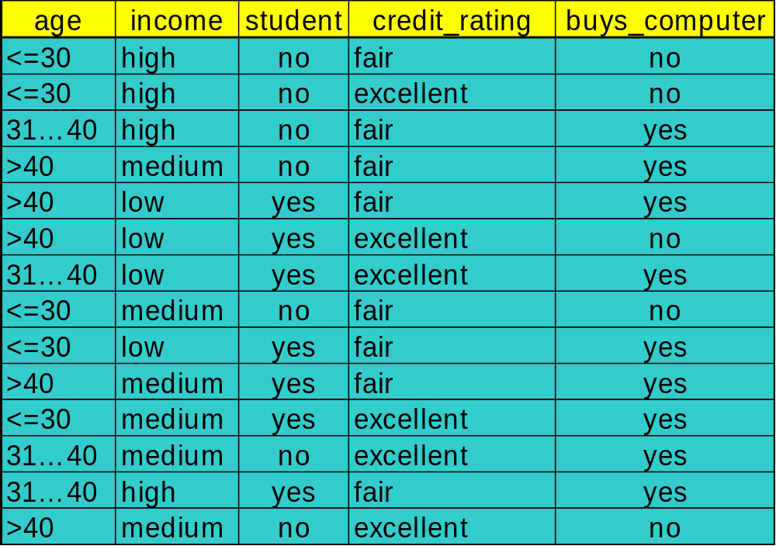
Training Dataset
Training data set: Buys_computer
The data set follows an example from Ross Quinlan’s Iterative Dichotomiser 3 (ID3) Algorithm which is used to generate decision trees

Slide 14
Output: A Decision Tree for “buys_computer”
Each internal node represents a test on an attribute
Each leaf node represents a class:
  Either buys_computer = “yes” or buys_computer = “no”
age?
<=30
overcast
>40
31..40
student?
yes
credit rating?
no
yes
excellent
fair
no
yes
no
yes

Slide 15
Why are decision tree classifiers so popular?
Decision trees can easily be converted to classification rules
Decision trees can handle high dimensional data
The construction of decision tree classifiers does not require any domain knowledge or parameter settings → appropriate for exploratory knowledge discovery
Information represented by tree → easy to be understood by human
Decision trees have good accuracy
The use of many applications:
  medicine, financial analysis, astronomy, molecular biology

Slide 16
Algorithm for Decision Tree Induction
Basic algorithm (a greedy algorithm)
  Tree is constructed in a top-down, recursive, divide-and-conquer manner
  At start, all the training examples are at the root
  Attributes are categorical
    Note: If continuous-valued, they are discretized in advance!
  Examples are partitioned recursively based on 3 splitting criterion (selected attributes to be used to split) as the tree is being built
  Test attributes are selected on the basis of a heuristic or statistical measure (e.g., information gain)
Conditions for stopping partitioning
  All samples for a given node belong to the same class
  There are no remaining attributes for further partitioning – majority voting is employed for classifying the leaf
  There are no samples left
Notes:
Check different splitting criteria and possible scenarios in the book

Slide 17
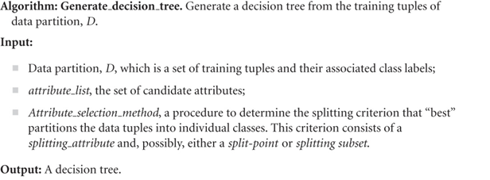
Decision Tree Induction Algorithm

Slide 18
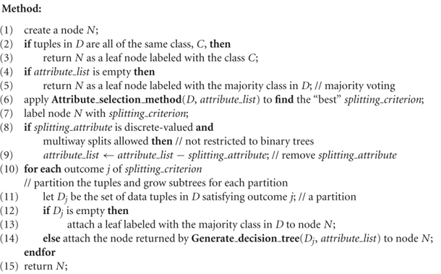
Decision Tree Induction Algorithm

Slide 19
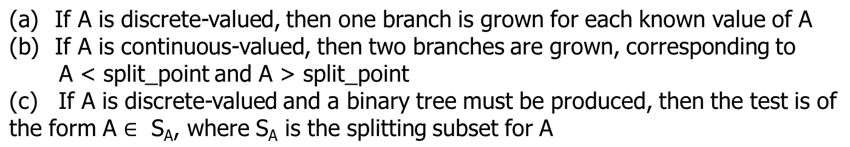
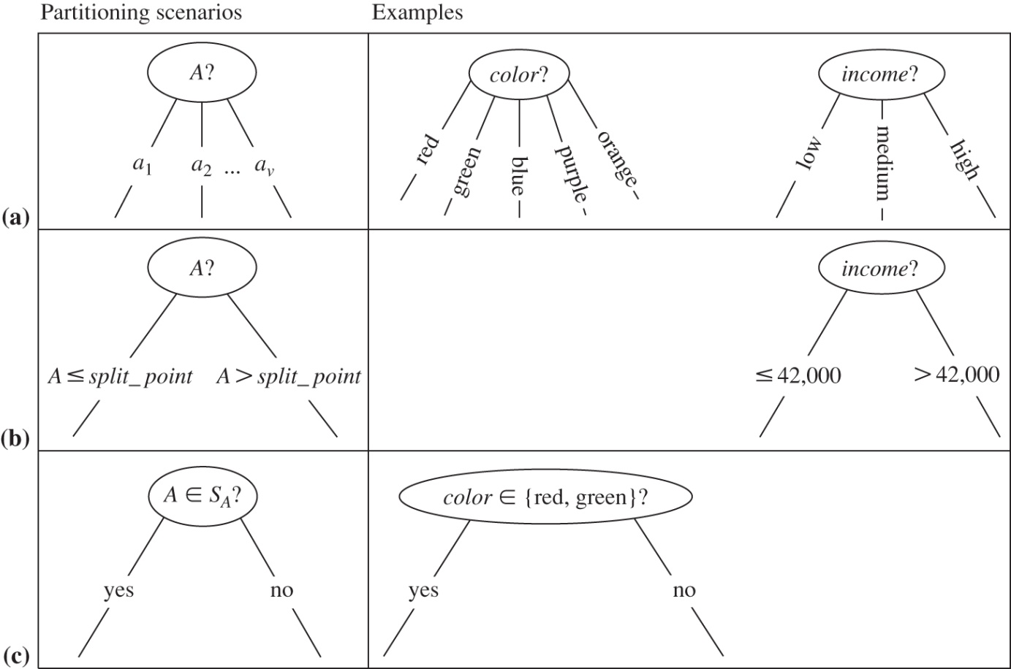
Partitioning Tuples based on Splitting Criterion

Slide 20
Attribute Selection Measure
An attribute selection measure: is a heuristic for selecting the splitting criterion that “best” separates a given data partition into individual classes
Ideally, each partition is pure: all of the tuples that fall into a given partition would belong to the same class
Conceptually, the “best” splitting criterion is the one that most closely results in pure partitions
The attribute having the best score for the measure is chosen as the splitting attribute

Slide 21
Attribute Selection Measure: Information Gain
Selects the attribute with the highest information gain
This is based on Quinlan’s ID3/C4.5 Algorithms
Advantages:
  minimizes the expected number of tests needed to classify a given tuple
  guarantees that a simple tree is found

Slide 22
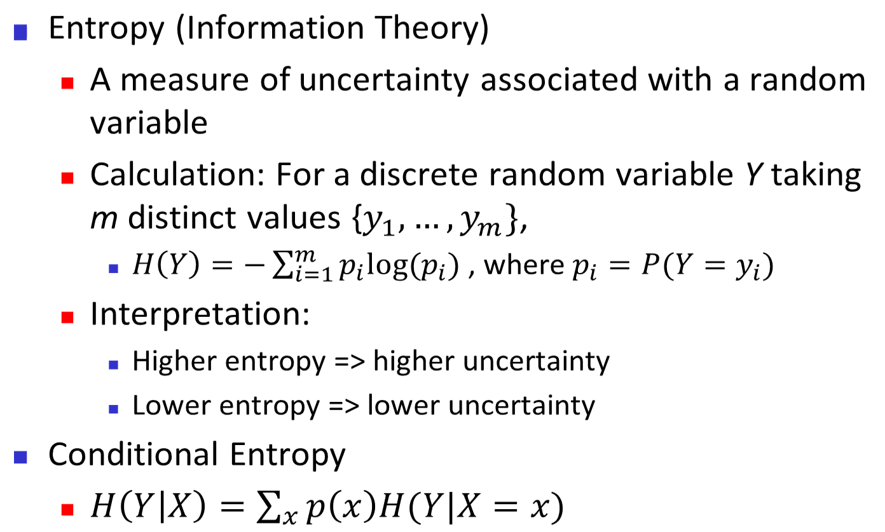

Entropy
m = 2

Slide 23
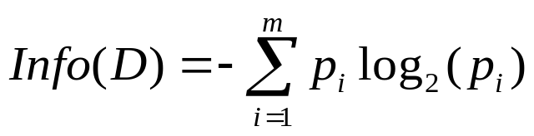
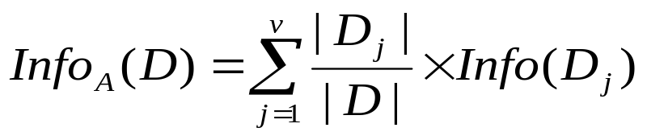


Attribute Selection Measure: Information Gain
Let D be the data partition, and the class label attribute has m distinct values defining m distinct classes
Let p_{i} be the probability that an arbitrary tuple in D belongs to class C_{i}, estimated by |C_{i, D}| / |D|
Expected information (entropy) needed to classify a tuple in D
The entropy of D,
Information (residual information) needed (after using A to split D into v partitions) to classify D:
Information gained by branching on attribute A
The most “informative” attribute is the one that maximizes Gain (minimizes residual information )
Notes:
I : the expected information needed to classify a given sample
E (entropy) : expected information based on the partitioning into subsets by A
After we have learned the value of attribute A, we only need some remaining amount of information to classify the object

Slide 24
Attribute Selection Measure: Information Gain
Suppose we want to partition D on some attribute A with values {a₁,a₂,…,a_{v}}
Attribute A can be used to split D into v partitions
{D1, D2, …, Dv}, where Dj contains those tuples in D that have outcome aj of A
  These partitions correspond to the branches grown from node N holding tuples of partition D may not be pure
Information needed to classify D:
  How much more information do we still need (after splitting D into v partitions using A) to arrive at an exact classification (pure)?
Notes:
InfoA(D) is the expected information required to classify a tuple from D based on the partitioning by A
The smaller that value is, the grater the purity of the partitions

Slide 25
Attribute Selection Measure: Information Gain
Information gained by branching on attribute A
  The difference between the original information requirement and the new requirement
  Gain(A) tells us how much would be gained by branching on A
The attribute A with the highest information gain is chosen as the splitting attribute at node N
Notes:
Check example on calculating the information gain in the book!
You need to go through the entire example to understand how the algorithm works

Slide 26
Summary of Information Gain
Let D be the data partition, and the class label attribute has m distinct values defining m distinct classes
Let p_{i} be the probability that an arbitrary tuple in D belongs to class C_{i}, estimated by |C_{i, D}| / |D|
Expected information (entropy) needed to classify a tuple in D
The entropy of D,
Information (residual information) needed (after using A to split D into v partitions) to classify D:
Information gained by branching on attribute A
The most “informative” attribute is the one that maximizes Gain (minimizes residual information )
Notes:
I : the expected information needed to classify a given sample
E (entropy) : expected information based on the partitioning into subsets by A
After we have learned the value of attribute A, we only need some remaining amount of information to classify the object

Slide 27

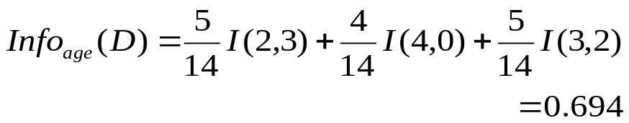



Attribute Selection: Information Gain
Class P: buys_computer = “yes”
Class N: buys_computer = “no”
means “age <=30” has 5 out of 14 samples, with 2 yes’es and 3 no’s Hence,
Similarly,

Slide 28
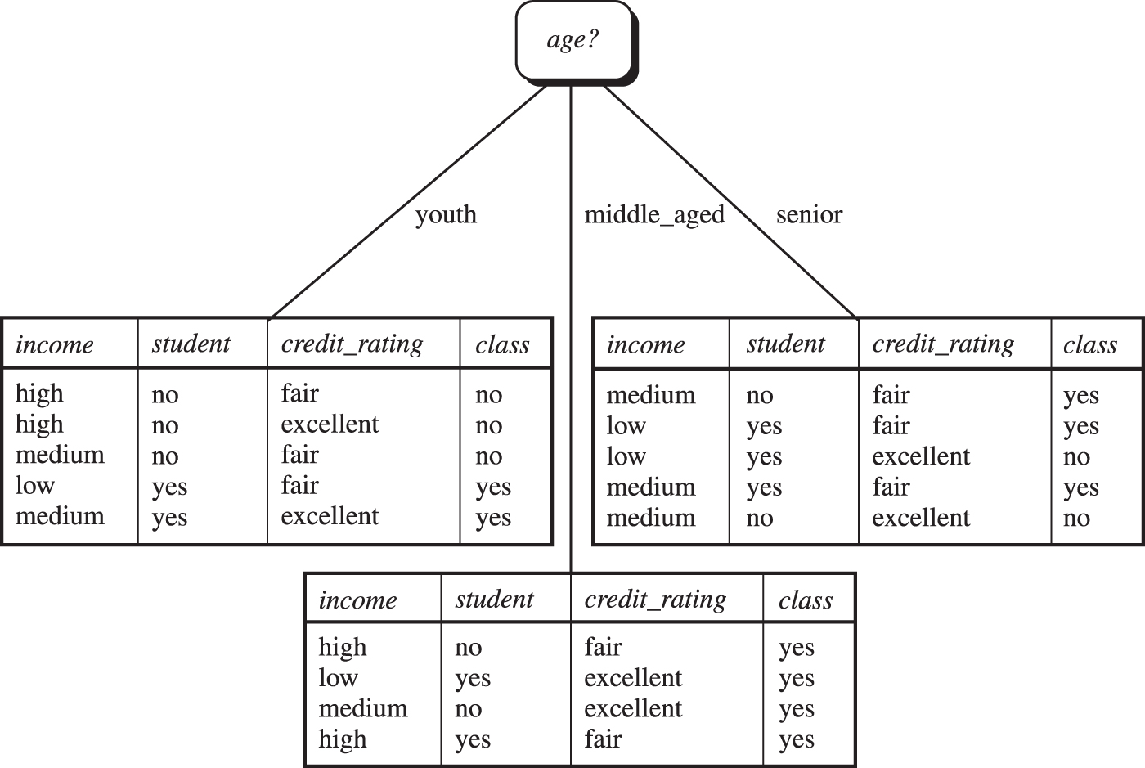
Attribute Selection: Information Gain
The attribute age has the highest information gain and hence it becomes the splitting attribute at the root node of the decision tree.
Branches are grown for each outcome of age
The tuples are shown partitioned accordingly.

Slide 29
Computing Information-Gain for Continuous-Valued Attributes
Let attribute A be a continuous-valued attribute
Must determine the best split point for A
  Sort the value A in increasing order
  Typically, the midpoint between each pair of adjacent values is considered as a possible split point
    (a_{i}+a_{i+1})/2 is the midpoint between the values of a_{i} and a_{i+1}
  The point with the minimum expected information requirement for A is selected as the split-point for A
Split:
  D1 is the set of tuples in D satisfying A ≤ split-point,
  D2 is the set of tuples in D satisfying A > split-point

Slide 30
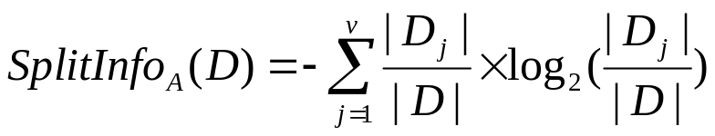
Gain Ratio for Attribute Selection (C4.5)
Information gain measure is biased towards attributes with a large number of values
C4.5 (a successor of ID3) uses gain ratio to overcome the problem (normalization to information gain)
  ss
  GainRatio(A) = Gain(A) / SplitInfo(A)
  Ex:
  gain_ratio(income) = 0.029/1.557 = 0.019
The attribute with the maximum gain ratio is selected as the splitting attribute

Slide 31


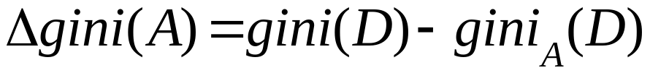
Gini Index (CART, IBM IntelligentMiner)
If a data set D contains examples from n classes, gini index, gini(D) is defined as
, where p_{j} is the relative frequency of class j in D
If a data set D is split on A into two subsets D₁ and D₂, the gini index gini(D) is defined as
Reduction in impurity:
The attribute provides the smallest gini_{split}(D) is chosen to split the node

Slide 32



Computation of Gini Index Example
Ex. D has 9 tuples in buys_computer = “yes” and 5 in “no”
Suppose the attribute income partitions D into 10 in D₁: {low, medium} and 4 in D₂
  Gini_{{low,high}} is 0.458; Gini_{{medium,high}} is 0.450. Thus, split on the {low,medium} (and {high}) since it has the lowest Gini index
All attributes are assumed continuous-valued

Slide 33
Comparing Attribute Selection Measures
The three measures, in general, return good results but
  Information gain (ID3):
    biased towards multivalued attributes
  Gain ratio (C4.5):
    tends to prefer unbalanced splits in which one partition is much smaller than the others
  Gini index:
    biased to multivalued attributes
    has difficulty when # of classes is large
    tends to favor tests that result in equal-sized partitions and purity in both partitions
Notes:
Composite attributes
Multivalued attributes

Slide 34
Extracting Classification Rules from Trees
Represent the knowledge in the form of IF-THEN rules
One rule is created for each path from the root to a leaf
Each attribute-value pair along a path forms a conjunction
The leaf node holds the class prediction
Example
  IF age = “<=30” AND student = “no” THEN buys_computer = “no”
  IF age = “<=30” AND student = “yes” THEN buys_computer = “yes”
  IF age = “31…40” THEN buys_computer = “yes”
  IF age = “>40” AND credit_rating = “excellent” THEN buys_computer = “yes”
  IF age = “<=30” AND credit_rating = “fair” THEN buys_computer = “no”

Slide 35
Enhancements to Decision Tree Induction
Allow for continuous-valued attributes
  Dynamically define new discrete-valued attributes that partition the continuous attribute value into a discrete set of intervals
Handle missing attribute values
  Assign the most common value of the attribute
  Assign probability to each of the possible values
Attribute construction
  Create new attributes based on existing ones that are sparsely represented
  This reduces fragmentation, repetition, and replication

Slide 36
Avoid Overfitting in Classification
Overfitting: An induced tree may overfit the training data
  Too many branches, some may reflect anomalies due to noise or outliers in training data
  Avoid overfitting by removing the least reliable branches
Two approaches to avoid overfitting:
  Prepruning: Halt tree construction early—do not split a node if this would result in the goodness measure (e.g., information gain) falling below a threshold
    Difficult to choose an appropriate threshold
  Postpruning: Remove branches from a “fully grown” tree—get a sequence of progressively pruned trees
    At each internal node, decide whether to keep or prune based on cost complexity and error rate
    Use a set of data, pruning set, different from the training data to decide which is the “best pruned tree”
Notes:
Pruned tree are simpler, less complex, faster and better at correctly classifying unseen datasets

